Slide 1
Lecture 5
Local and global truncation errors

Slide 2
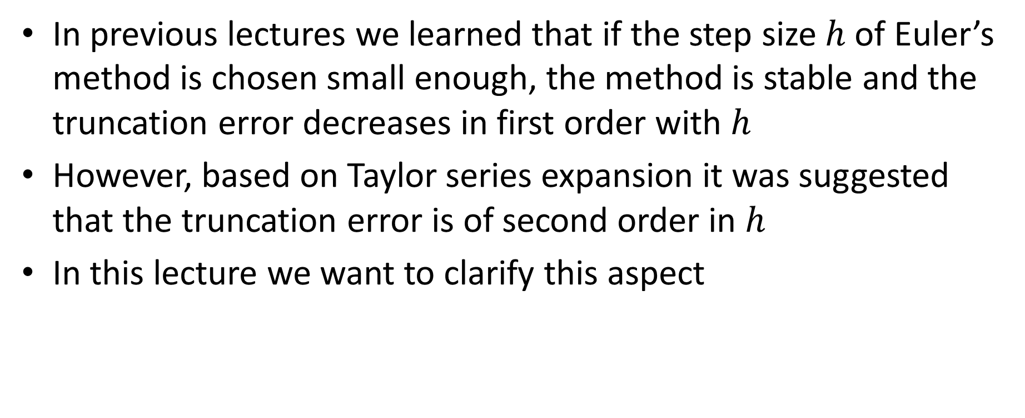
Introduction
In previous lectures we learned that if the step size $h$ of Euler’s method is chosen small enough, the method is stable and the truncation error decreases in first order with $h$
However, based on Taylor series expansion it was suggested that the truncation error is of second order in $h$
In this lecture we want to clarify this aspect
Notes:
In previous lectures we learned that if the step size $h$ of Euler’s method is chosen small enough, the method is stable and the truncation error decreases in first order with $h$
However, based on Taylor series expansion it was suggested that the truncation error is of second order in $h$
In this lecture we want to clarify this aspect and understand why we have this contradiction

Slide 3

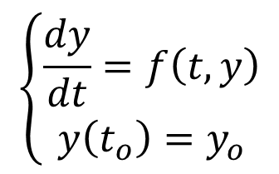









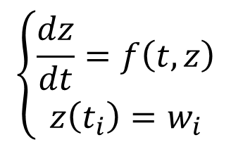
Truncation Errors
$$\left\{\begin{aligned}\frac{dy}{dt}=f\left(t,y\right) \\ y\left(t_{o}\right)=y_{o}\end{aligned}\right.$$
$$y$$
$$y\left(t_{i+1}\right)$$
$$y(t)$$
global truncation error
$$\left\{\begin{aligned}\frac{dz}{dt}=f\left(t,z\right) \\ z\left(t_{i}\right)=w_{i}\end{aligned}\right.$$
$$y\left(t_{i}\right)$$
$$z(t)$$
$$w_{i+1}$$
$$w_{i}$$
local truncation error
$$t_{i}$$
$$t_{i+1}$$
$$t$$
Notes:
Let us consider an initial value problem with the differential equation $\frac{dy}{dt}=f\left(t,y\right)$ and initial condition $y\left(t_{o}\right)=y_{o}$
Let y(t) be the exact solution of this problem
This exact solution has the value y(ti) in ti
Imagine that the IVP solver did produce the approximation wi for t=ti.
Let us now analyze how the IVP solver will determine the approximation in ti+1
First, the exact solution will have the value y(ti+1)
Euler’s method does calculate wi+1 by extrapolating linearly the solution wi.
It does this by using the slope of the solution in the point (ti, wi)
The slope is however not that slope of the exact solution y(ti)
It is the slope of a solution z(t) of our differential equation passing by the point (ti,wi)
This solution z(t) is the exact solution of a different initial value problem than the one we are solving.
The differential equation is the same, but the initial value is $z\left(t_{i}\right)=w_{i}$
This solution z(t) is called the local solution.
Note that in each step ti, there will be a new local solution z(t).
Extrapolating linearly z(t) from the point (ti,wi) leads us to the approximation wi+1 computed by Euler’s method
The difference between wi+1 and the local solution z(ti+1) is called the local truncation error
In fact, Euler’s method, as any other IVP solver, attempts to minimize this local truncation error.
But the error we actually care about is the difference between our solution y(ti+1) and wi+1.
This difference is called the global truncation error
What is important to realize is that there is no simple relation between the local truncation error and the global truncation error.
For example, the global truncation error is not made out of simple additions of successive local errors. The relation is more complex because in each step i, the IVP solver jumps to a different local solution, progressively driving away further and further from the solution y(t) one wants to approximate.
IVP solvers are indeed very tricky and complex mathematical objects
Such algorithms are much more difficult to handle than all algorithms we saw until now in the course

Slide 4



Truncation errors
Definitions
Exact solution $y\left(t\right)$ is the exact solution of
Local solution $z\left(t\right)$ in $t_{i}$ is the exact solution of
Approximation in $t_{i}$ produced by the IVP solver: $w_{i}$
Global truncation error in $t_{i+1}$: $\left|y\left(t_{i+1}\right)−w_{i+1}\right|$
Local truncation error in $t_{i+1}$: $\left|z\left(t_{i+1}\right)−w_{i+1}\right|$
$$\left\{\begin{aligned}\frac{dy}{dt}=f\left(t,y\right) \\ y\left(t_{o}\right)=y_{o}\end{aligned}\right.$$
$$\left\{\begin{aligned}\frac{dz}{dt}=f\left(t,z\right) \\ z\left(t_{i}\right)=w_{i}\end{aligned}\right.$$
Notes:
It is worth to introduce some definitions
The exact solution $y\left(t\right)$ is the exact solution of the initial value problem $\begin{aligned}\frac{dy}{dt}=f\left(t,y\right)\end{aligned}$ with initial condition $y\left(t_{o}\right)=y_{o}$
The local solution $z\left(t\right)$ in $t_{i}$ is the exact solution of $\frac{dz}{dt}=f\left(t,z\right)$, the same differential equation as for the exact solution y(t), but with initial condition $z\left(t_{i}\right)=w_{i}$
The approximation in $t_{i}$ produced by the IVP solver is denoted $w_{i}$
The global truncation error in $t_{i+1}$ is the difference between the exact solution and the approximation computed by the IVP solver. That is $\left|y\left(t_{i+1}\right)−w_{i+1}\right|$
The local truncation error in $t_{i+1}$ is the difference between the local solution and the approximation computed by the IVP solver. That is $\left|z\left(t_{i+1}\right)−w_{i+1}\right|$

Slide 5
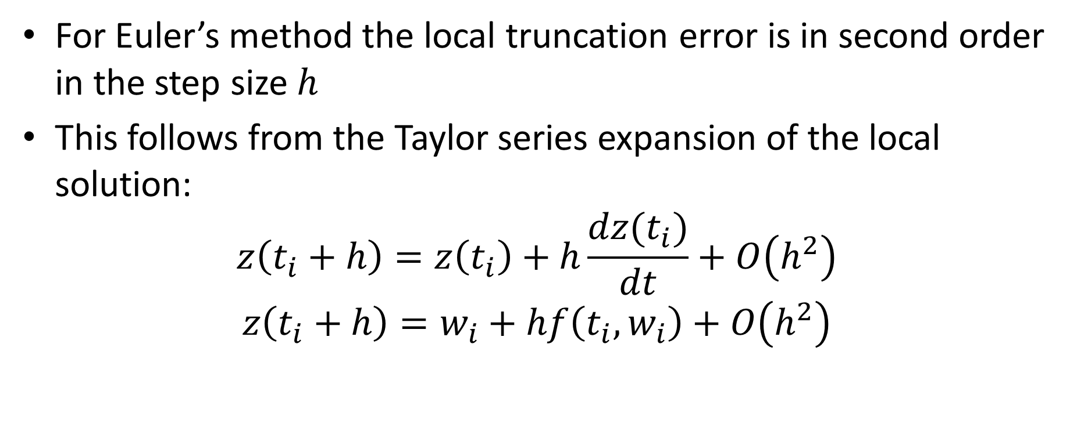
Local truncation error
For Euler’s method the local truncation error is in second order in the step size $h$
This follows from the Taylor series expansion of the local solution:
$$z\left(t_{i}+h\right)=z\left(t_{i}\right)+h\frac{dz(t_{i})}{dt}+O\left(h^{2}\right)$$
$$z\left(t_{i}+h\right)=w_{i}+hf\left(t_{i},w_{i}\right)+O\left(h^{2}\right)$$
Local truncation
error
Euler’s method
Notes:
With our understanding of the difference between local and global truncation error we can now explain why Taylor series expansion lead us to the wrong order in the step size h.
In fact, for Euler’s method the local truncation error is in second order in the step size $h$
This follows from the Taylor series expansion of the local solution
We have that
$$z\left(t_{i}+h\right)=z\left(t_{i}\right)+h\frac{dz(t_{i})}{dt}+O\left(h^{2}\right)$$
But as $\frac{dz(t_{i})}{dt}$ is equal to $f\left(t_{i},z(t_{i})\right)$ according the differential equation z(t) satisfies we can further write
$$z\left(t_{i}+h\right)=w_{i}+hf\left(t_{i},w_{i}\right)+O\left(h^{2}\right)$$
We used here that fact that $z(t_{i})$ is equal to wi by definition of the local solution z(t)
From this equation we can read out Euler’s method and we can read out that the truncation error is in second order in h. This being the truncation error obtained based on the local solution z(t), it means that we found the local truncation error

Slide 6
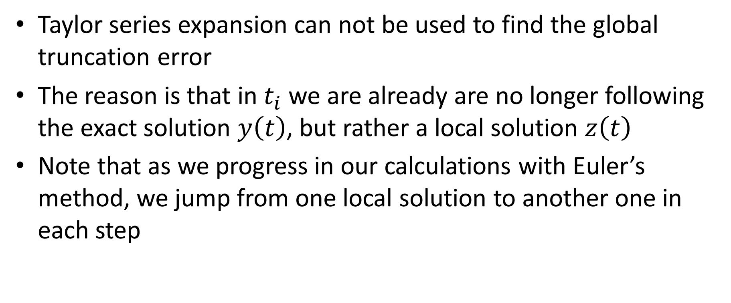
Global Truncation Error
Taylor series expansion can not be used to find the global truncation error
The reason is that in $t_{i}$ we are already are no longer following the exact solution $y\left(t\right)$, but rather a local solution $z\left(t\right)$
Note that as we progress in our calculations with Euler’s method, we jump from one local solution to another one in each step
Notes:
Let us now turn to the global truncation error
Unfortunately Taylor series expansion can not be used to find the global truncation error
The reason is that in $t_{i}$ we are already are no longer following the exact solution $y\left(t\right)$, but rather a local solution $z\left(t\right)$
As we already mentioned before, note that as we progress in our calculations with Euler’s method, we jump from one local solution to another one in each step

Slide 7
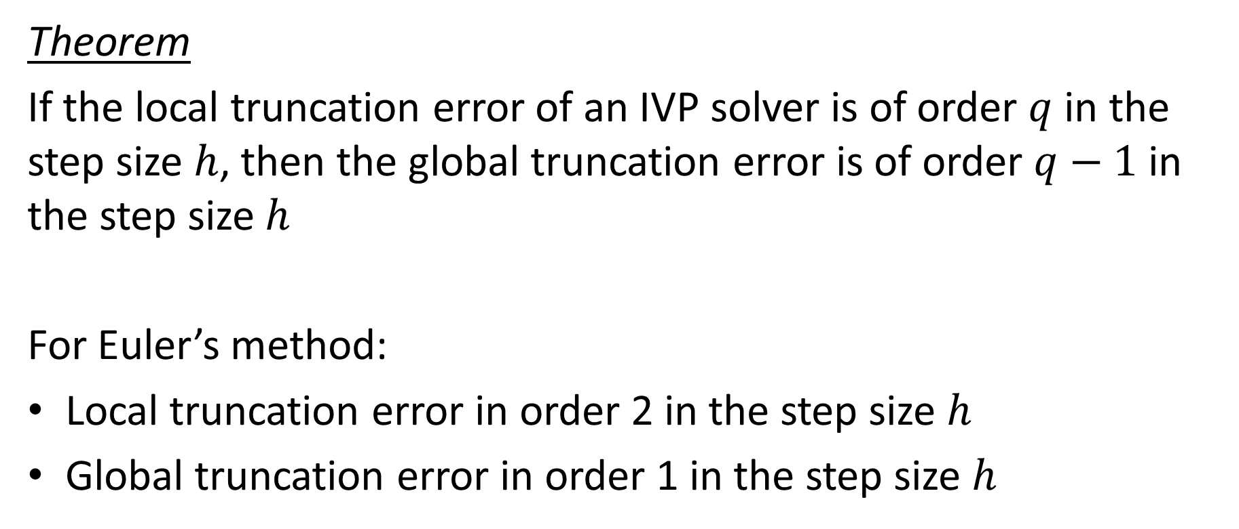
Relation between local and global truncation error
Theorem
If the local truncation error of an IVP solver is of order $q$ in the step size $h$, then the global truncation error is of order $q−1$ in the step size $h$
For Euler’s method:
Local truncation error in order 2 in the step size $h$
Global truncation error in order 1 in the step size $h$
Notes:
Luckily there exist a theorem that links local and global truncation error. The derivation of this theorem is not straight forward and we will not present it
The theorem reads:
If the local truncation error of an IVP solver is of order $q$ in the step size $h$, then the global truncation error is of order $q−1$ in the step size $h$
This theorem has a very high practical value as we will progressively learn in the reminder of this course
First consequence, which we use now, it allows to know the order of the global truncation error of an IVP solver if we know the order of the local truncation error.
For Euler’s method we just derived two slides ago that the local truncation error in order 2 in the step size $h$
Consequently the lgobal truncation error in order 1 in the step size $h$

Slide 8
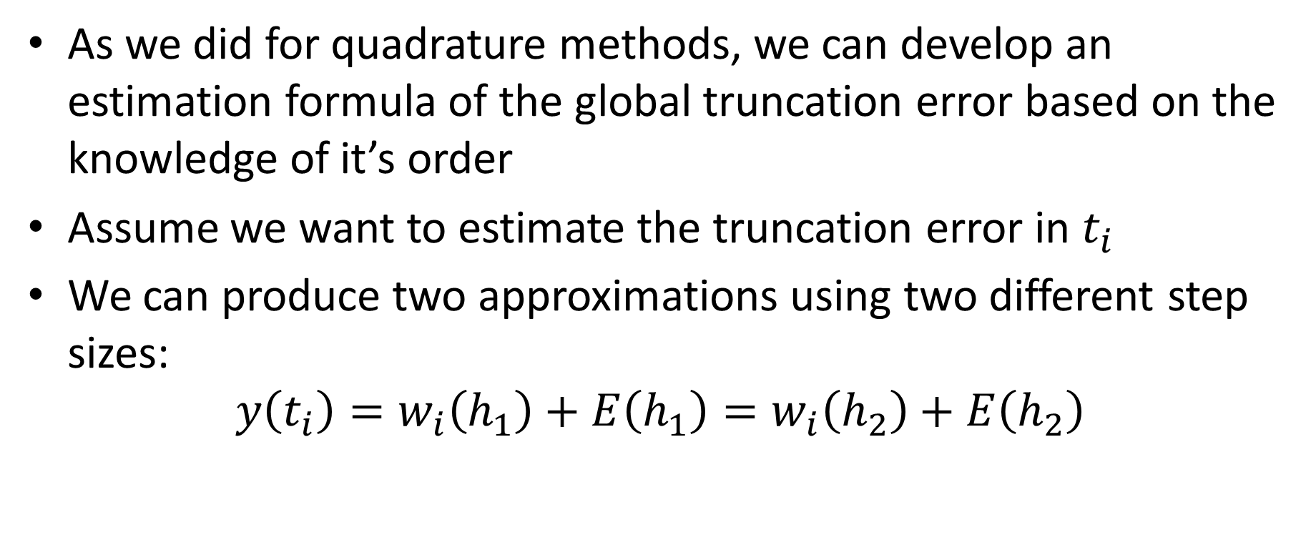

Estimating global truncation errors
As we did for quadrature methods, we can develop an estimation formula of the global truncation error based on the knowledge of it’s order
Assume we want to estimate the truncation error in $t_{i}$
We can produce two approximations using two different step sizes:
$$y\left(t_{i}\right)=w_{i}\left(h_{1}\right)+E\left(h_{1}\right)=w_{i}\left(h_{2}\right)+E\left(h_{2}\right)$$
$$w_{i}$$
Notes:
As we did for quadrature methods, we can develop an estimation formula of the global truncation error based on the knowledge of it’s order
We follow exactly the same procedure.
I encourage you to review the lecture on the Richardson error formula in the lesson on numerical integration in case you face difficulties in the coming developments
To start, let us assume we want to estimate the truncation error in $t_{i}$ of our approximation wi
We can produce two approximations using two different step sizes
In equations:
$y\left(t_{i}\right)=w_{i}\left(h_{1}\right)+E\left(h_{1}\right)$ if we use a step size h1
But $y\left(t_{i}\right)$ is as well equal to $w_{i}\left(h_{2}\right)+E\left(h_{2}\right)$ is we use a step size h2

Slide 9
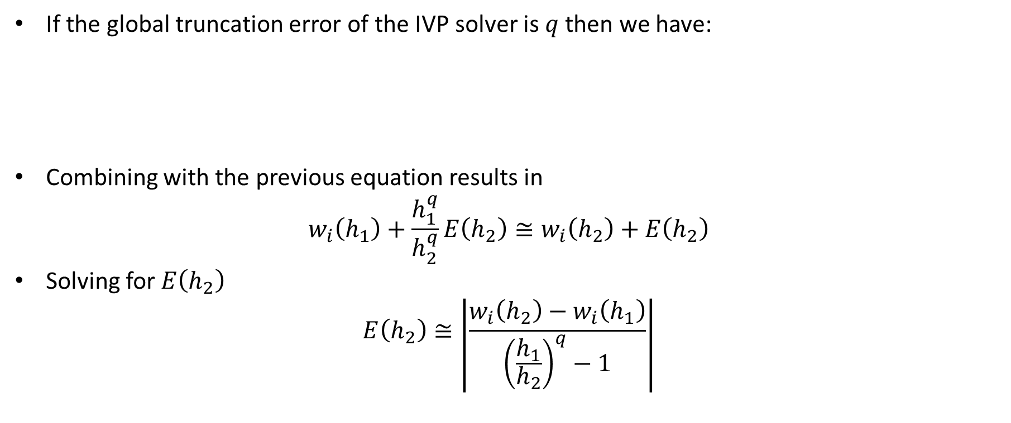



Estimating global truncation errors
If the global truncation error of the IVP solver is $q$ then we have:
Combining with the previous equation results in
$$w_{i}\left(h_{1}\right)+\frac{h_{1}^{q}}{h_{2}^{q}}E\left(h_{2}\right)≅w_{i}\left(h_{2}\right)+E\left(h_{2}\right)$$
Solving for $E\left(h_{2}\right)$
$$E\left(h_{2}\right)≅\left|\frac{w_{i}\left(h_{2}\right)−w_{i}\left(h_{1}\right)}{{\left(\frac{h_{1}}{h_{2}}\right)}^{q}−1}\right|$$
$$E\left(h_{1}\right)≅Ch_{1}^{q}$$
$$\frac{{E(h}_{1})}{E(h_{2})}≅\frac{h_{1}^{q}}{h_{2}^{q}}$$
$$E\left(h_{2}\right)≅Ch_{2}^{q}$$
Notes:
Let us assume that the global truncation error of our IVP solver is in order q
In this case we can write that
the global truncation error when using the step size h1 is about $Ch_{1}^{q}$
and the global truncation error when using the step size h2 is about $Ch_{2}^{q}$
Combining these relations results in $\frac{{E(h}_{1})}{E(h_{2})}≅\frac{h_{1}^{q}}{h_{2}^{q}}$
Using our previous result allow us to write
$$w_{i}\left(h_{1}\right)+\frac{h_{1}^{q}}{h_{2}^{q}}E\left(h_{2}\right)≅w_{i}\left(h_{2}\right)+E\left(h_{2}\right)$$
Solving for $E\left(h_{2}\right)$ gives us the estimation of the truncation error:
$$E\left(h_{2}\right)≅\left|\frac{w_{i}\left(h_{2}\right)−w_{i}\left(h_{1}\right)}{{\left(\frac{h_{1}}{h_{2}}\right)}^{q}−1}\right|$$
This formula is called the Richardson error formula

Slide 10
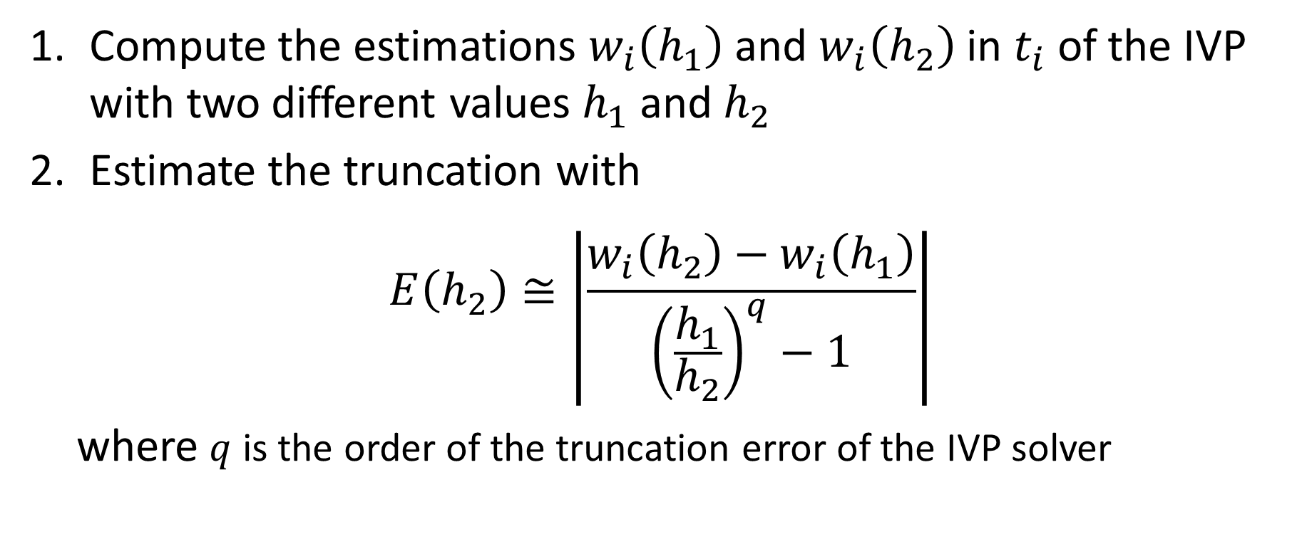
Estimating global truncation errors for IVP solvers
Compute the estimations $w_{i}\left(h_{1}\right)$ and $w_{i}\left(h_{2}\right)$ in $t_{i}$ of the IVP with two different values $h_{1}$ and $h_{2}$
Estimate the truncation with
$$E\left(h_{2}\right)≅\left|\frac{w_{i}\left(h_{2}\right)−w_{i}\left(h_{1}\right)}{{\left(\frac{h_{1}}{h_{2}}\right)}^{q}−1}\right|$$
where $q$ is the order of the truncation error of the IVP solver
Notes:
The Richardson error formula is very useful to estimate the global truncation error in practical applications
For this we proceed in two steps
First: we compute the estimations $w_{i}\left(h_{1}\right)$ and $w_{i}\left(h_{2}\right)$ in $t_{i}$ of the initial value problem with two different step sizes $h_{1}$ and $h_{2}$ using our solver
Second, we estimate our global truncation error using the Richardson formula
Recall that $q$ is the order of the global truncation error of the used IVP solver

Slide 11

Example
We consider the following IVP problem:
$$\left\{\begin{aligned}\frac{dy}{dt}=−2y \\ y\left(0\right)=1\end{aligned}\right.$$
Exact solution:
$$y\left(t\right)=e^{−2t}$$
Notes:
To illustrate the usage of Richardson's error formula we consider an example
We will solve the initial value problem $\frac{dy}{dt}=−2y$ with initial condition y(0)=1
This simple IVP has the exact solution $y\left(t\right)=e^{−2t}$
We will use this exact solution to evaluate if our Richardson formula gives good approximations or not of the truncation error

Slide 12
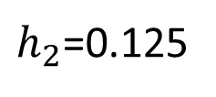

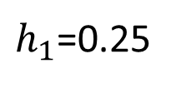
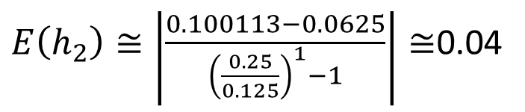
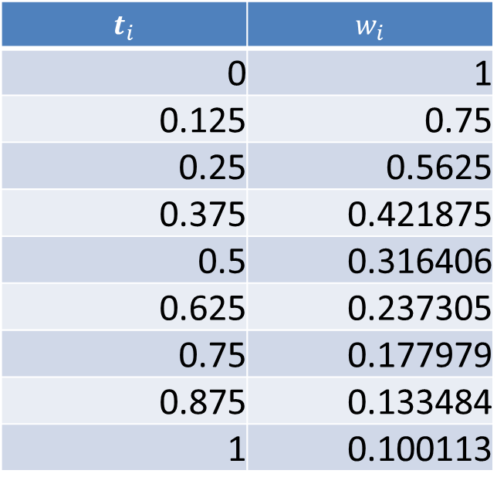
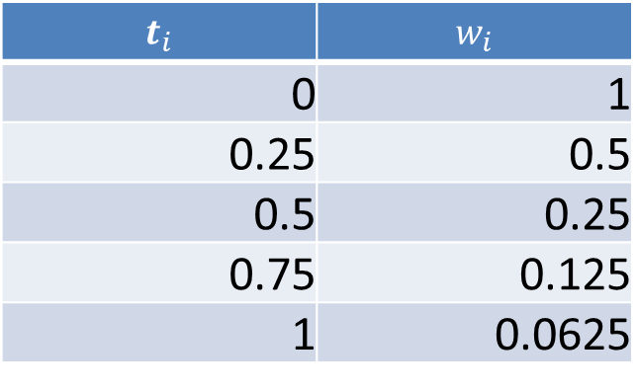
Example
We compute the approximations in $t=1$
$h_{1}$=0.25
$h_{2}$=0.125
$$t_{i}$$ | $$w_{i}$$
0 | 1
0.25 | 0.5
0.5 | 0.25
0.75 | 0.125
1 | 0.0625
$$t_{i}$$ | $$w_{i}$$
0 | 1
0.125 | 0.75
0.25 | 0.5625
0.375 | 0.421875
0.5 | 0.316406
0.625 | 0.237305
0.75 | 0.177979
0.875 | 0.133484
1 | 0.100113
$E\left(h_{2}\right)≅\left|\frac{0.100113−0.0625}{{\left(\frac{0.25}{0.125}\right)}^{1}−1}\right|≅$0.04
Notes:
We want to estimate the truncation error for the approximation in t=1
For this we compute the approximation in in t=1 with Euler’s method using two different step sizes
First we use the step size h1=0.25
This results in the table shown
I invite you to try to reproduce this table
Then we repeat the same calculations with another step size. Here we choose h2=0.125
This results in the table shown
I invite you to try to reproduce this table
Note that the procedure is quite lengthy.
Indeed, to compute the second table we have to restart from scratch
Now that we have two approximations in t=1 with two different step sizes we can apply Richardson’s error formula to estimate the truncation error
We obtain an error of about 0.04

Slide 13

Example
In summary we can say:
$$y\left(1\right)≅0.10±0.04$$
Exact solution:
$$y\left(1\right)=e^{−2}≅0.14$$
Notes:
In summary we can say that $y\left(1\right)≅0.10±0.04$
We can compare this with the exact solution which is about 0.14
We can conclude that Richardson’s error formula gives an acceptable estimation of the error

Slide 14
Summary
One has to distinguish between local and global truncation error for IVP solvers
The global truncation error is the difference between the exact solution of the IVP and the approximation produced by the IVP solver
The local truncation error is the difference between the local solution and the approximation produced by the IVP solver
The order of the global truncation error is one less than the local truncation error
Richardson’s error formula allows to estimate the global truncation error
Notes:
Let us summarize the key findings
One has to distinguish between local and global truncation error for IVP solvers
The global truncation error is the difference between the exact solution of the IVP and the approximation produced by the IVP solver
The local truncation error is the difference between the local solution and the approximation produced by the IVP solver
The order of the global truncation error is one less than the local truncation error
Richardson’s error formula allows to estimate the global truncation error

